Slide 1
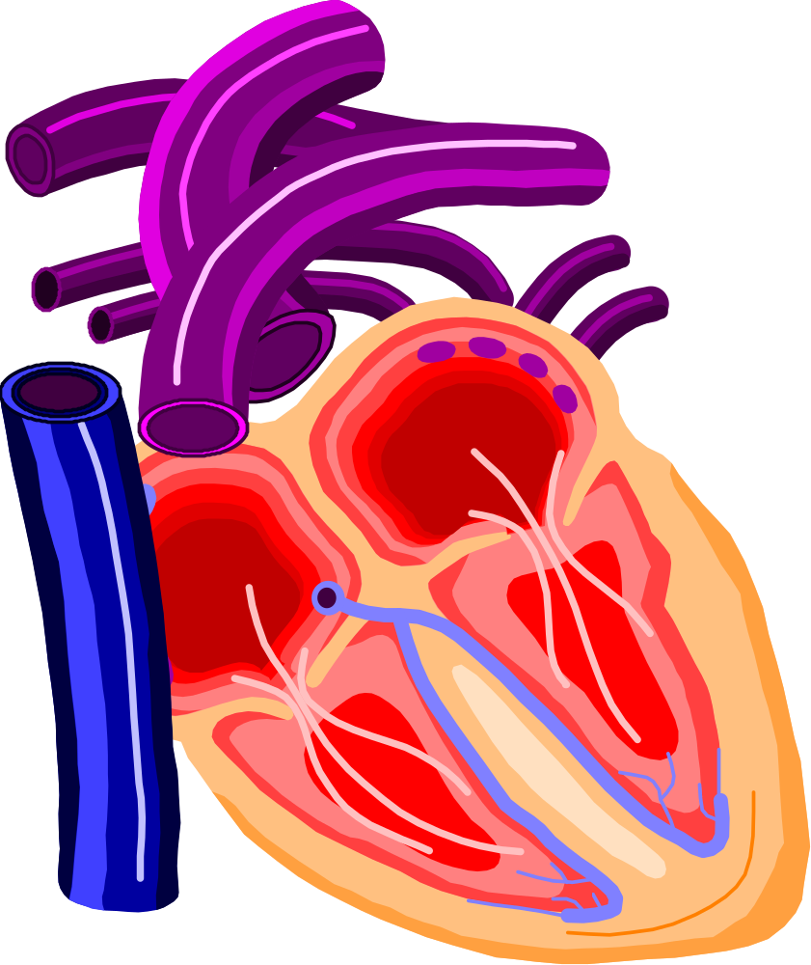
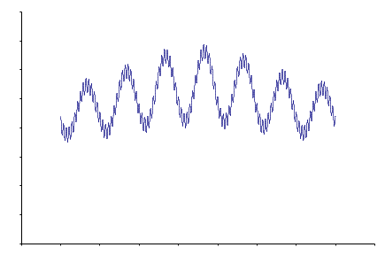
The Phoenix Project
Introduction – El Nolley
Sensors – Carl Schu
Application Software – Larry Beaty
Usage – Germaine Cornelissen
© 2007 Ellis S. Nolley
Copying and distribution of this document is permitted in any medium, provided this notice is preserved http://www.phoenix.tc-ieee.org/

Slide 2

Introduction
Objectives
Open Source - Process & Organization
Architecture
Roadmap
History
Volunteers
Feel free to ask questions about any of this during Q&A

Slide 3
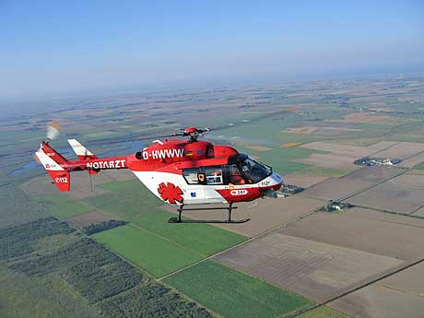
Overview
Objectives
Inexpensive
Unobtrusive
Easy to Use
Collects a Week of
  BP Measurements
Architecture
Local Subsystem
Sensors <- Volunteers needed
Power
Processor
Memory
Display
Communications
System Software
Application Software
Remote Subsystem
Hardware
System Software
Application Software <- Volunteers needed
Volunteers needed for prototyping projects in all areas
& Project Managers
Notes:
Notes:
Additionally, would like people with expertise in
Project Management
Recruiting

Slide 4
… to Sensors

Slide 5
Q&A

Slide 6
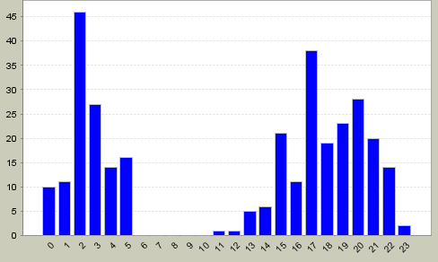
Activity
Ambulatory Blood Pressure Monitor (ABPM) Design
  Calibration with a Oscillometric Cuff | Project Champion: Bob Schlentz | Status: proposed project
Sensors | Team Champion: Carl Schu
  Sensor Team Collaboration Wiki
  Blood flow
    Piezo Film Blood Flow Sensor | Project Champion: Carl Schu | Status: active project
    Optoelectric Blood Flow Sensor | Status: proposed project
    Impedance Plethysmograph Sensor | Project Champion: Wade Peterson
  Piezo Film Body Motion Sensor | Project Champion: John Gould | Status: active project
  Low Power Microprocessor | Project Champion: Curt McNamara | Status: active project
Data Analysis
  Data Analysis Methods | Project Champion: Germaine G Cornelissen-Guillaume | Status: active project
  Data Analysis Software
    Systems Architecture and Engineering: Project Champion: Chris Adams | Status: active project
    Methodology and Systems Management: Project Champion: Chris Adams | Status: active project
  Sphygmochron Spreadsheet | Project Champion: Larry Beaty | Status: active project
  Test Data
Clinical Applications
  Clinical Care Support System | Project Champions: Gerry Werth | Status: active project
Regulatory
  Regulatory Approval | Project Champion: El Nolley | Status: active project
  Quality System | Project Champion: Norm Bayne | Status: active project
Information
  Physiology and Blood Pressure Measurement | Project Champion: Bob Schlentz | Status: proposed project

Slide 7
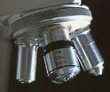
Objectives
Diagnosis & Treatment
Clinical Program
Project
Measurement
Program
Product
Development
Public Health
& Public Policy
Inexpensive: Price no barrier, ~$10 desired.
Unobtrusive: Not aware of it.
Easy to Use: Ignore it. Indicates OK. See BP&HR
Week of Measurements: BP & HR needed. BF & Motion desired

Slide 8
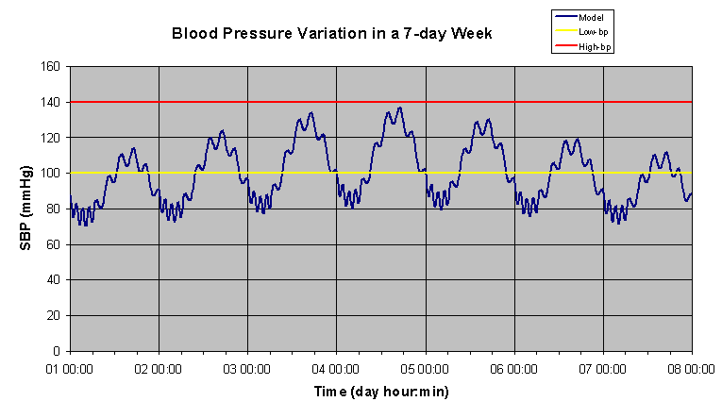
Benefit
Monitor BP for long term use on massive scale to obtain measures of health, and to encourage the development of diagnostic, prevention and treatment techniques.
Eliminate: heart attack, Stroke, Kidney disease, retinopathy, and other major handicapping and fatal diseases.
Substantially Reduce: healthcare costs (50%?).
Action: Baseline individual’s BP cycle, periodic update for preventative healthcare.
Business impediment: Seems not doable directly but requires a catalyst. Like the free browser was needed to develop online shopping.

Slide 9
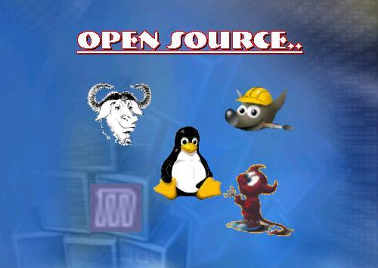
Open Source
Problem: Market for for-profit mass market ABPM too small.
Goal: Lowest price, zero equilibrium price.
Solution - Open Source:
  Eliminates IP, Minimizes Dev & Mktg costs.
  Tradeoff is Time and Control.
  Focus on community – volunteers – worldwide.
  “Business” function: Catalyzes for-profit services and add-on products.
  Process: Prototype everything, then formal development.

Slide 10
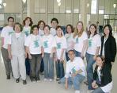
Global Volunteer Community
Project Team
. . .
Project Team
Coordinating Team
Website: real time development & collaboration.
  All project leads have logons for their page & subpages.
Every activity is “project”.
Email list servers:
  Team coordination.
Coordinating team meets every two weeks.
Anyone can start a project. Disagreements are settled by alternative projects via “show me.”
Project “currency” is the energy & enthusiasm of the volunteers

Slide 11

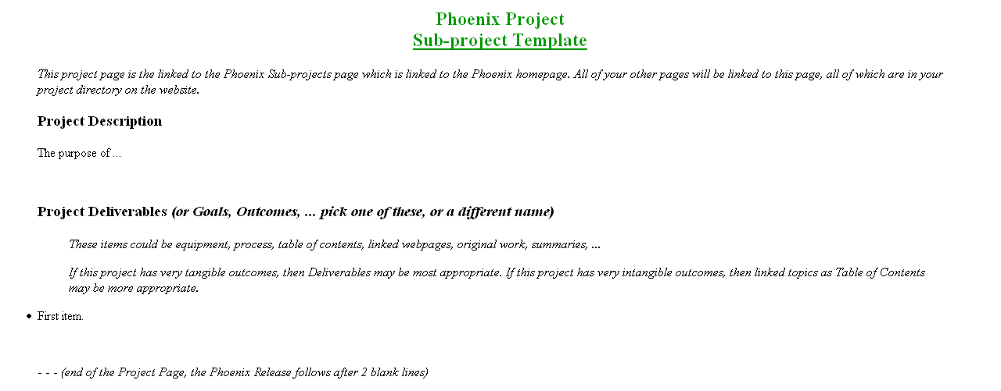
Starting a Project
Web Page
Project
Plan
Project
Plan
Coordinating
Project
Plan
Project
Project
Home
Page
Team
Lead
Project
Deliverables

Slide 12

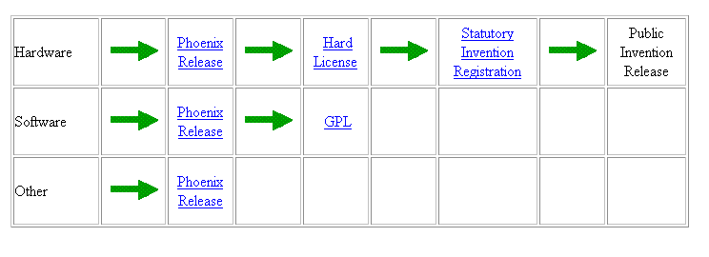
Intellectual Property
Phoenix Release
About This Page
This page is maintained by Your-Name. It was last updated on 28 October 2007.
The author(s) provide this information as a public service, and agree to place any novel and useful inventions disclosed herein into the public domain. They are not aware that this material infringes on the patent, copyright, trademark or trade secret rights of others. However, there is a possibility that such infringement may exist without their knowledge. The user assumes all responsibility for determining if this information infringes on the intellectual property rights of others before applying it to products or services.
Copyright (C) 2007 Your-Name. Copying and distribution of this page is permitted in any medium, provided this notice is preserved.

Slide 13

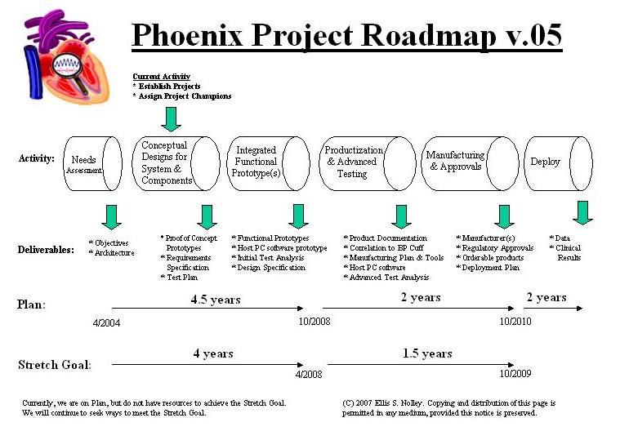
Roadmap

Slide 14

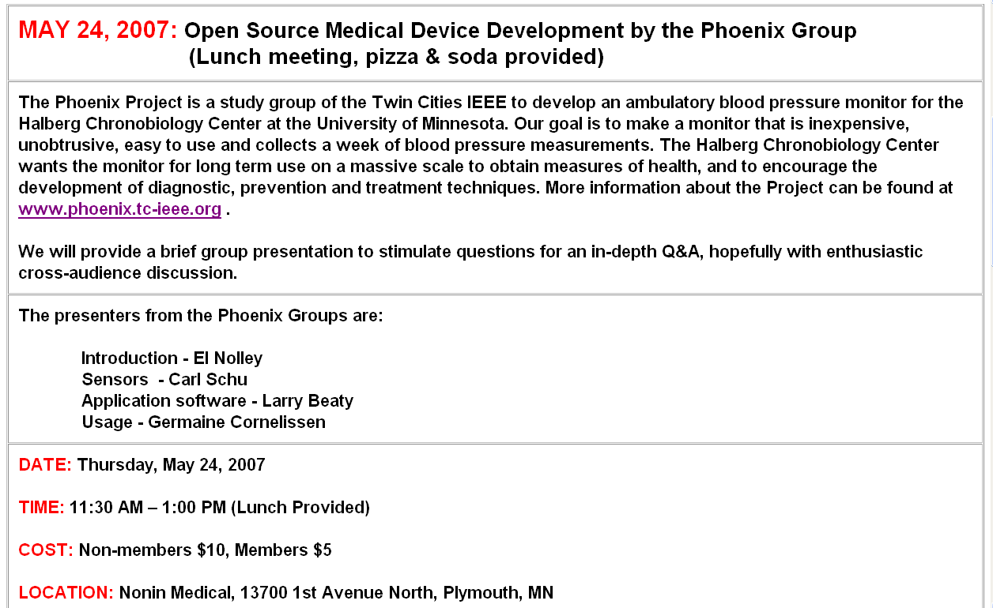
Presentation Announcement
Engineers in Medicine and Biology Society

Slide 15
Topics for Questions
Introduction
Objectives
Why Open Source
How We Start a Project
Roadmap
Project Activity
Sensor
Piezo Film
Other Potential Implementations
Improvement Ideas
How We Perform a Project
Problems
Software
System & SW Arch. Components
Sphygmochron – Problems & Issues
What Does the Report Look Like?
Test Driven SW Development
User Stories and req. development
Usage
BP is Highly Variable
Impact on Health.
Analysis
Treatment
Chronobiologic Appoach

